Slide 1
Local Work Groups
Washington State

Slide 2
WA Local Work Groups
Proud and active history - known nationally
WA State took LWG input seriously
2003 – WACD offer of assistance
10 LWGs formed (9+1 tribal)
Multi-county – multi-district
Active in all details of past program implementation
Conservation priorities & prevalence
Practice eligibility
Ranking questions & points
Cost share rates (%)
Hold-downs for practice incentive
Funding pools (eventually)

Slide 3
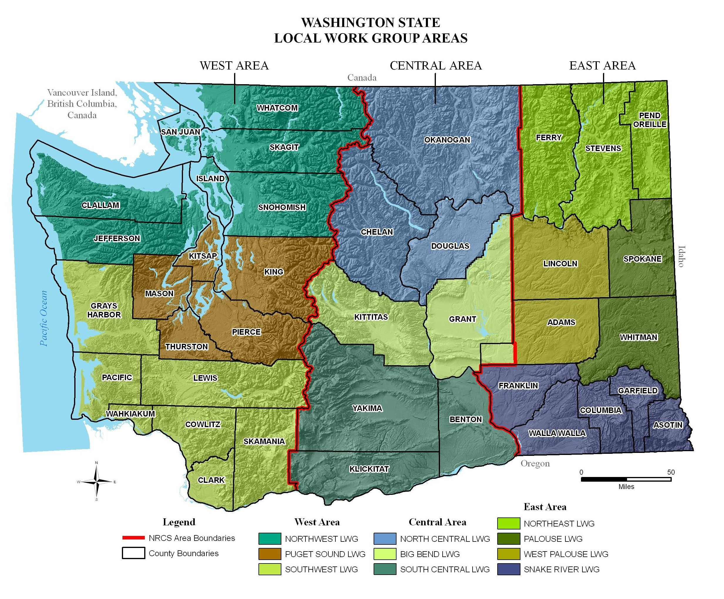

Slide 4
Things That Are Working & Why
Funding pools (2006 to present)
Provided opportunity to direct funding to resource needs
Each LWG with their own operating procedures
Local control and leadership
Resource conservation priorities
Local input and direction
Maps & resource data
Allowing local work groups to define their priorities, estimate acres needing treatment

Slide 5
Things That Are Working & Why
State Resource Data & Assessment
built from local input and state data sets
Strong partnerships with CD’s
built over years…265 district employees
Task Orders with CD’s
wildlife, CRP, engineering, field work, promotion
Partnerships on CRP planning with Districts & FSA
contracting with CDs and WDFW
Energy Initiative Outreach to irrigators and partners
high amount of interest.

Slide 6
Things That Are Not Working & Recommendations
Funding directed at national and state priorities
More funding directed to local priorities
STAC sub-committee (technical)
Ability for a technical subcommittee to have influence on a practice standard – nutrient management, buffers
High Late Rate of Implementation
Concentrate on workload related to implementation
TSP agreements with Conservation Districts
RMS Planning Strategy
NRCS staff training, Producer willingness to RMS plan
Funds divided into too many pools, subdivisions
Less pools & highest priorities

Slide 7
Things That Are Not Working & Recommendations
Not enough NRCS staff for technical assistance
TSP agreements with Conservation Districts
CRP takeout & workload issues
Assistance to producers with conservation plans that are considering taking CRP out of program
TSP agreements with Conservation Districts
Farm Bill uncertainty
Guidelines and program rules completed in timely manner
Deadlines
Communicate deadlines early so workload can be managed

Slide 8
Things That Are Not Working & Recommendations
Duplicate Applications & Ranked in Separate Sub Pools
Less sub pools for application ranking
Cultural Resource Investigations
Continue agreements with CDs, cultural resource specialists, & tribes

Slide 9
Vision and Objectives for LWG Operations in FY 2015
LWGs will address resource concerns and use of all programs, not just EQIP
Funding will be targeted to resource concerns
Simplified processes and workload reduction
Examine state level ranking questions
LWGs will identify which initiatives they support
LWGs will identify special priorities or projects

Slide 10
Special Projects/initiatives
Farm Bill Extension/New Farm Bill
High Tunnel Initiative
Energy Initiative
Organic/Transition
Conservation Partnership Initiative
Sage Grouse Initiative
Wildfire Initiative – LWG priority
Greenhouse Gas EQIP (#cover crops )
CD(s) funded CRP takeout under No-Till scenario
WRP Restoration Contracts

Slide 11
Packages Due May 16
Completed Data Collection Worksheets:
LWG Resource Priorities by Land Use
75% to top three concerns from SRA
Estimated Priority Treatment Acres
Local Ranking Questions and Points
Key Conservation Practices (and additional practices)
Hold Downs
Estimated Priority Treatment Acres for:
National Initiatives
State Initiatives
Identify Local Projects

