Slide 1
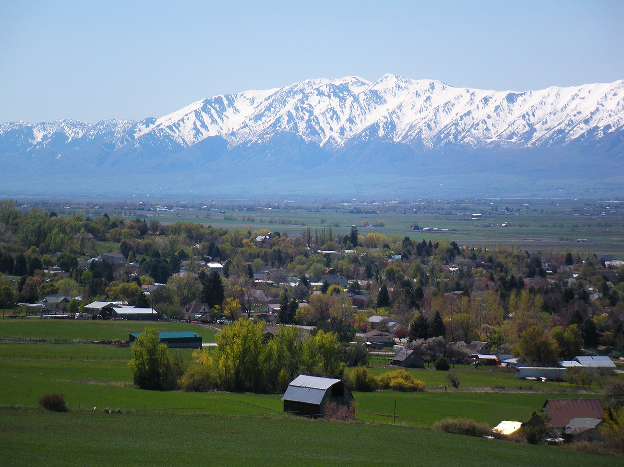
THE CACHE-RICH LOCAL WORK GROUP
Presented by: S. Bruce Karren, North Cache CD Chairman and LWG Chairman (2013-2014)
Bracken Henderson, Zone 1 Resource Coordinator
Thayne Mickelson, Utah Conservation Commission Executive Director
Jon Hardman, NRCS District Conservationist

Slide 2
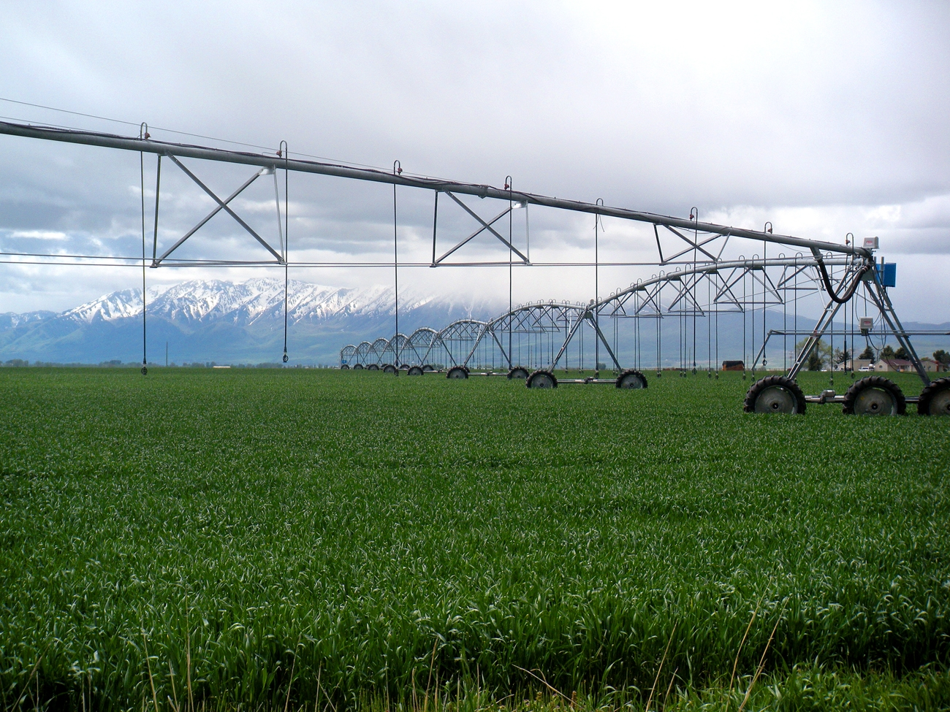
THE CACHE-RICH LOCAL WORK GROUP
Functions as a “Clearing House” for projects and ideas
Meets twice annually (Spring & Fall)
Three Conservation Districts (North Cache, Blacksmith Fork and Rich)
Utah Association of Conservation Districts
State Agencies
Utah Dept. of Ag and Food (UDAF)
Utah Dept. of Environmental Quality (UDEQ)
Division of Water Quality (DWQ)
Federal Agencies
USDA–NRCS
USDA-FSA
USF&WS
Local Government
Cache County Council
Multicounty (Cache & Rich)

Slide 3
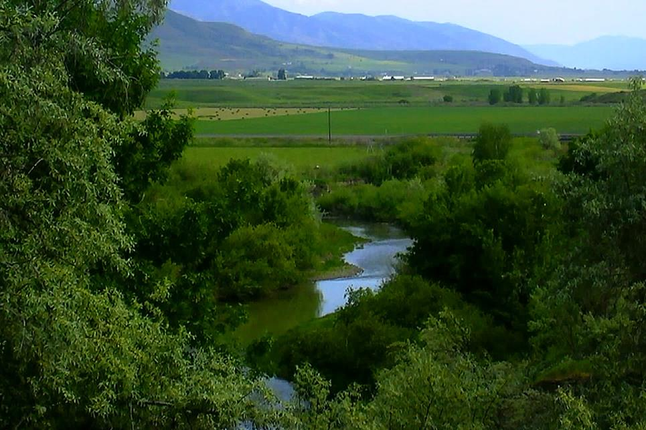
WHAT IS WORKING WELL …
County by County Resource Assessments
Top Five Priorities Identified
Updated every five years (reviewed annually)
Grill the Districts
In the fall of the year
Stakeholders & Public Input
Broader than just NRCS Conservation Programs
Consensus on Priorities regardless of County or Conservation District
Good Coordination amongst participants

Slide 4
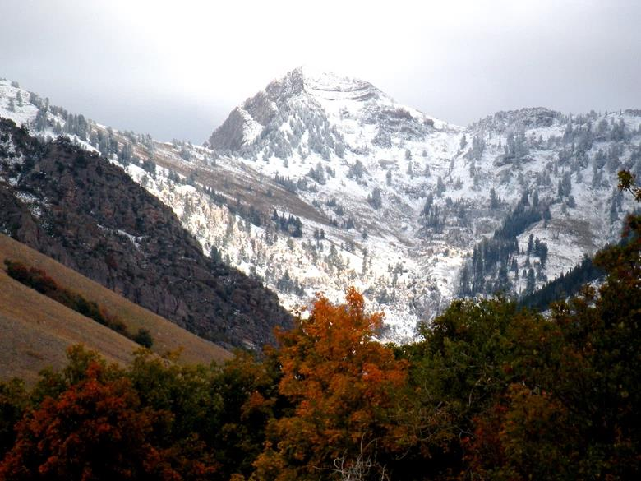
WHAT’S NOT WORKING WELL …
Changing Programs, Priorities, & Deadlines
Participation with some Agencies (FS, BLM, UDWR, FFSL)
Pre-meeting project/proposal development

Slide 5
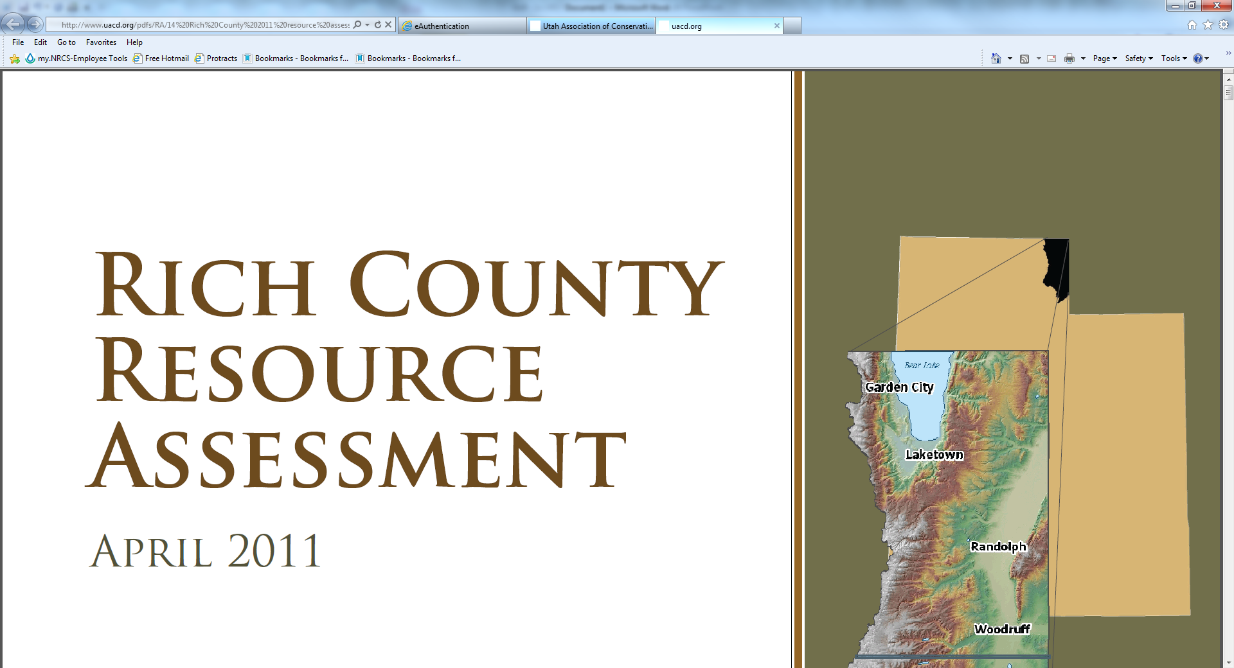
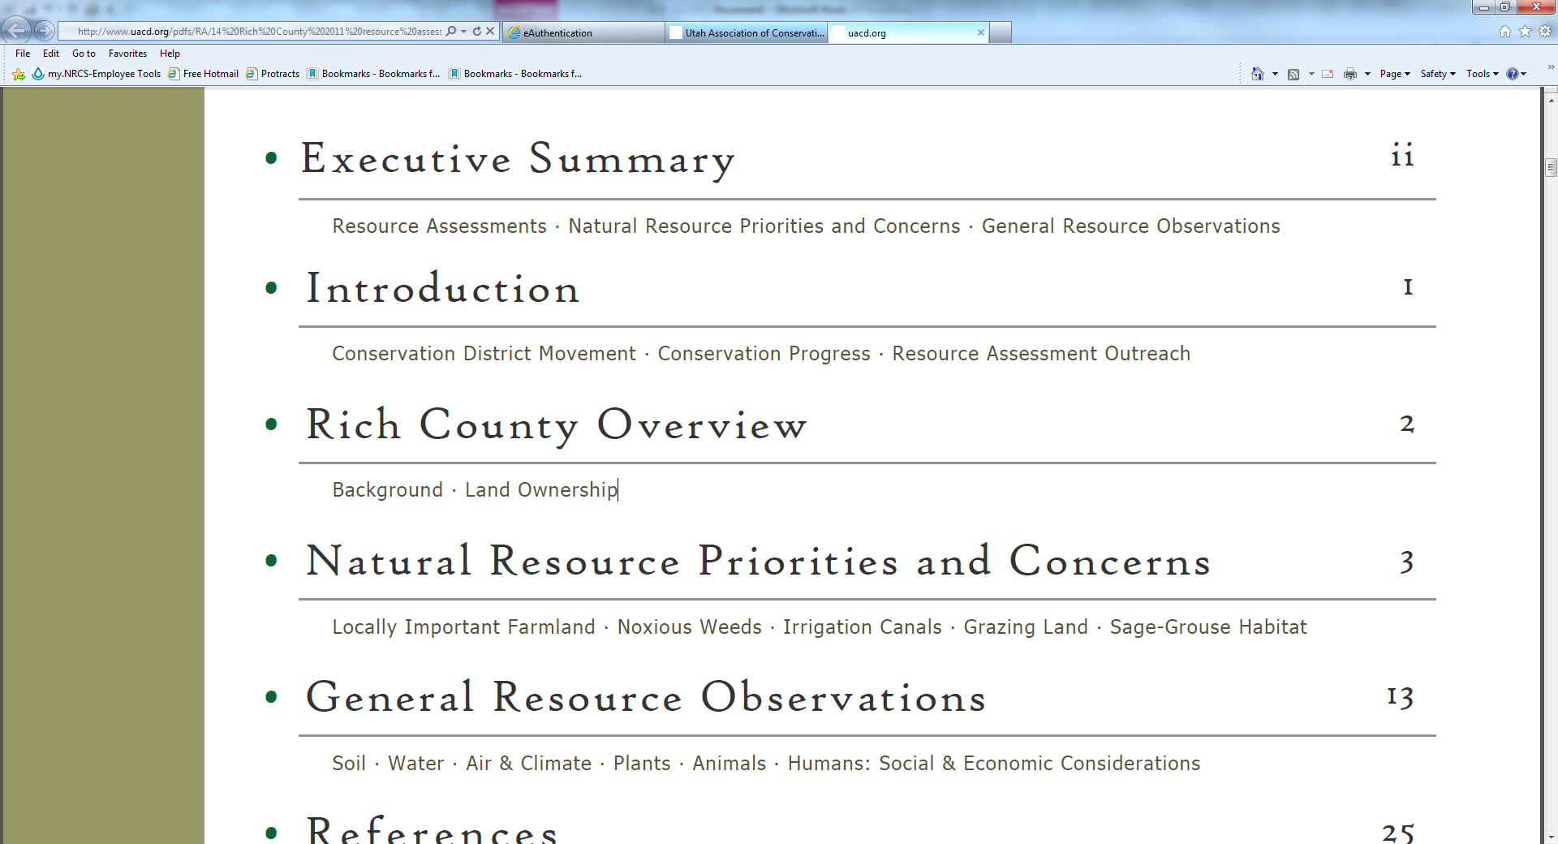
RECOMMENDATIONS
County Resource Assessments (www.UACD.org)
USDA/Districts Open House (Grill the District Day)
Clearly defined LWG roles and purpose (Clearing House)
Use of Technology (Outreach & Participation)
Pre-meeting Preparation (Project Proposals further developed)

