Slide 1
Recruiting & Retaining Outstanding Board Members
National Association of State Conservation Agencies Informational Webinar
February 23, 2017

Slide 2
Welcome to NASCA’s Webinar
Mike Brown – NASCA Executive Director
Ray Ledgerwood – Moderator
Board Works by Ledgerwood
Webinar ID: 553-688-331
Join on the web at: www.joingotowebinar.com
Join the audio at:
(213) 929-4232
Access code: 326-834-046
Pin provided on dashboard

Slide 3
Welcome & Opening Comments
Mike Brown
NASCA Executive Director

Slide 4
Logistics
All muted lines except presenters
Questions
via web – use dashboard on your computer
Will get to as many questions as we can
Testimonials
Unmute individuals that raise hand
Presentation recorded
Feedback welcome – kudos, comments, etc – email mike-brown@nascanet.org

Slide 5
Description
NASCA informational webinar on tips and ideas for recruiting outstanding board members for your conservation district, state association, and state conservation boards.
Learn from examples of successful board member recruiting from across the nation.

Slide 6
Opening Comments
“When you get where you're goin' Don't forget turn back around And help the next one in line
Always stay humble and kind”
Humble And Kind
Tim McGraw

Slide 7
Agenda
Agenda & Session Purpose
Qualities We Want in Our Board Members
Motivations to Serve as a Board Member
The “Next” Board Member Needed
Recruitment Methods
Testimonials from Participants
Open Questions & Discussion

Slide 8
Questions
Use Dashboard questions area to ask questions of speakers via the web

Slide 9
Examples
Use Dashboard to raise hand to provide a testimonial of success in recruitment and retention of board members
Will unmute your line

Slide 10
Qualities We Want in Our Board Members
Individuals draft the top 3 qualities you want in your board members
Enter the top qualities we want in the questions area of your dashboard

Slide 11
Qualities We Want in Our Board Members

Slide 12
Motivations to Serve as a Board Member or Associate
History
District Powers
Personal Motivations
“The” Question – “What Do You Want to Accomplish”

Slide 13
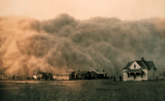
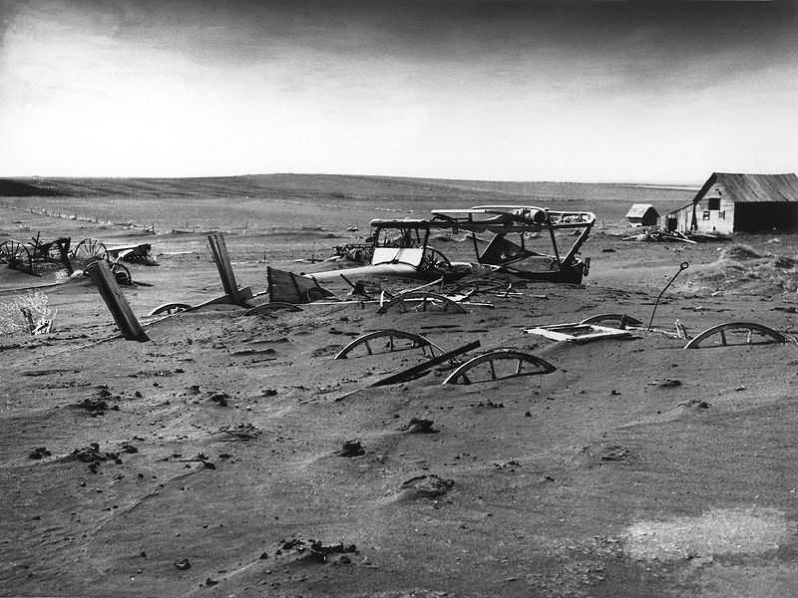
A dust storm approaches Stratford, Texas, in 1935.
1930’s Dust Bowl
Buried machinery in a barn lot; Dallas, South Dakota, May 1936

Slide 14
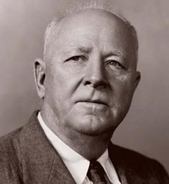
History
The beginning – Hugh Hammond Bennett
Congressional Hearing
Notes:
Hugh Hammond Bennett (April 15, 1881 – July 7, 1960) was a pioneer in the field of soil conservation in the United States of America. He founded and headed the Soil Conservation Service, a federal agency now referred to as the Natural Resources Conservation Service. He co-wrote a United States Department of Agriculture publication in 1928 titled Soil Erosion: A National Menace. When the Soil Erosion Service was established as part of the United States Department of the Interior in September 1933, Bennett became the director. He continued to speak out on soil conservation issues, especially through the Dust Bowl years, and eventually influenced the passage of the soil conservation act of April 27, 1935, which created the Soil Conservation Service at the USDA. He remained at the head of that organization until he retired in 1951.

Slide 15
History
Soil Erosion a Menace to National Welfare.
Soil Erosion Service 1933 – operated out of Department of Interior.
Demonstration Sites.
Competition between agencies – Interior, Ag, Extension.

Slide 16
History
Soil Conservation Service (SCS) – Created April 1935 with Public Law 46.
SCS now Natural Resources Conservation Service (NRCS).
75 plus years of partnership with Conservation Districts.
SCS ➔ Conservation Districts
Trivia: Where was the first conservation district created?
Answer: Brown Creek Soil & Water Conservation District in North Carolina was the first district established.

Slide 17
History
Need for Local Guidance – Priorities, Culture, Credibility
Model Conservation District Law 1937

Slide 18
Powers of Soil Conservation Districts
Conduct Survey, Investigations & Research
Disseminate Information on BMPs
Conduct Demonstration Projects
Preventive & Control Measures
Cooperate or Enter Into Agreements
Real & Personal Property
Maintain, Administer, & Improve Acquired Properties

Slide 19
Powers of Conservation Districts
Sell, Lease or Dispose of District Property
Make Available Material or Equipment
Annual Plans of Work
Long Range Plans
Publish Plans
Any Soil Conservation or Water Quality Project
Agent for Federal or State Agencies for Any Conservation Project

Slide 20
Powers of Conservation Districts
Accept Gifts of Money, Services, Materials
Borrow Money
Approve or Disapprove Plans
Recommend & Implement a Fee System
Sue & Be Sued
Provide Contracting Services, Equipment & Supplies to Landowners

Slide 21
Personal Motivations
Political
Pride
Prestige
Purpose
Profit / Economic
Partners
Purpose
Business
Social
Community Service
Accomplishments
Heritage

Slide 22
“The” Question
“What Do You Want to Accomplish as a Board Member?”

Slide 23
The “Question”
“What do you want to accomplish as a Board Member?”
Becomes the basis for building an effective board
Board becomes successful through a support system
Individuals accomplish

Slide 24
Recruitment
Once known – recruitment is matching the personal motivation with opportunities to accomplish

Slide 25
Open Questions & Testimonials

Slide 26
Elements of Effective Recruitment
Cause
Need
Competition
Recruitment
Reward
Community
Examples

Slide 27
The Need
Analyzing the Needs of Your Board
Inventory Board programs & activities
Identify strengths, weaknesses, goals of Board
Identify the current talents of board members
Recruit for needed talents
Invite other organizations to recommend candidates with needed talents, experience, knowledge

Slide 28
The Need
Each State with Unique Election & Appointment Rules
Need to recruit
Need to help new people follow the election and appointment procedures

Slide 29
The “Next” Board Member Needed
Identify the resource, education, and business issues needing addressed in your Board, association on state board
Identify the expertise that the current board members bring to the board
Identify the expertise that is needed with the next board member that will be recruited

Slide 30
The “Next” Board Member Needed
Small group activity (each board) identifies the resource, education, and business issues needing addressed in your organization
Small group activity (each board) identifies the expertise that the current Board Members bring to the board.
Small group activity (each board) identifies the expertise that is needed with the next member that will be recruited

Slide 31
The Competition
Effective leaders are in high demand
Competition for talented people’s time
Family, friends, recreation, hobbies, work, interests, other volunteer activities
Competition with other organizations for talented people
Still need to match interests with opportunities – serving as a board member – your organization as important as other interests
Local to State to National positions

Slide 32
Community
Community Involvement
Communities Representation
Gender, Age, Ethnics, Interests, Education…
Create Opportunities for Diversity in Membership
Welcoming Culture
Still need to match interests with opportunities – serving as a board member would be as important as other interests

Slide 33
The Reward
Three Things all Board Members Need:
To know role and responsibilities
To be kept informed
To have a meaningful contribution

Slide 34
Recruitment Methods
District Prospectus
Position Description
Meeting with Other Organizations
Land Owners Active in District Programs
Group Discussion

Slide 35
District Prospectus
Potential board members need to know what the district is and does
District Function
Mission & Vision Statements
Your District’s Goals & Objectives
Legal Authority
Major Issues
Major Programs & Activities
Funding Sources
Expectations of District Board Members
Benefits of Being a District Board Member
The District Prospectus

Slide 36
Job Description
General Function
Duties & Responsibilities
Term of Service
Qualifications
Commitment Required
Training Requirements
Function of the Conservation District
Job Description Example

Slide 37
Recruitment Strategies & Materials
Example Strategies
Assemble a board development team
Develop a referral network
Board board members information form
Letter to organizations
Public service announcements
New releases
Official process for elections or appointments (state specific)

Slide 38
Recruitment Strategies & Materials
Example Strategies
Social Media
Newspaper Advertisements
Board Recruitment Brochure
Recommendations from Staff and Others
Recruitment at Annual & Special Meetings
Distributing Recruitment Prospectus & Job Description
Personal Contacts
Recipients of Our Services

Slide 39
Board Members Toolkit from Association Management – January 2002
Always show up
What’s your leadership legacy?
Get an early start on board materials
Look forward, not back
Continually review mission, vision, and plan
Strategic thinking is a special responsibility
Talk to new members
Bring in a member – it sets the needed example
Have your calendar with you
Understand the plan for crises
Figure out a filing system
Board work doesn’t take a holiday
Disagree at the board meeting, but present a united front
Ask for staff research help early
Rapid turnover of executives costs time and money

Slide 40
Board Members Toolkit from Association Management – January 2002
Deal with the name game now
Tune in to leading indicators
Grow room for members
Agree on what constitutes success
Achievement flows from the team at the top
Resist the temptation to micromanage
Bottom line: Money really matters
Be mindful of other people’s time as well as your own
Ask for great volunteers
Effect a wonderful transition

Slide 41
Open Questions & Testimonials

Slide 42
Questions
Use Dashboard questions area to ask questions of speakers via the web

Slide 43
Announcements
Join us for additional webinars
Visit www.nascanet.org for more information.

Slide 44
Closing Comments
Mike Brown
NASCA Executive Director

Slide 45
Board Works by Ledgerwood
Ray Ledgerwood
Owner
1260 SE Harvest Drive
Pullman, WA 99163
Cell 208.301.4728
Email rayledgerwood@msn.com

Slide 46
Effective Organizations
Goals
Working Environment
Tensions
Procedures

Slide 47
R before I and T
Relationships before issues and tasks
Relationship “Bank Account”
Deposits
Withdrawals
Overdrawn?

